Slide 1
HR ANALYTICS Employee retention

Slide 2
TEAM MEMBERS
PROJECT MENTOR
Srilakshmi.N
Paula Lalith
Paka Sharmila Sai
Ajay Sumukha
Manjula
Shivam
Bhagya Shree
Mitali
PROJECT CO-ORDINATOR

Slide 3
1.Introduction
2.kpi’s
3.Required Connections
4.Excel Dashboard
5.Power BI Dashboard
6.Tableau Dashboard
7.MYSQL Queries
8.Insights and Recommendations
9.Summary

Slide 4
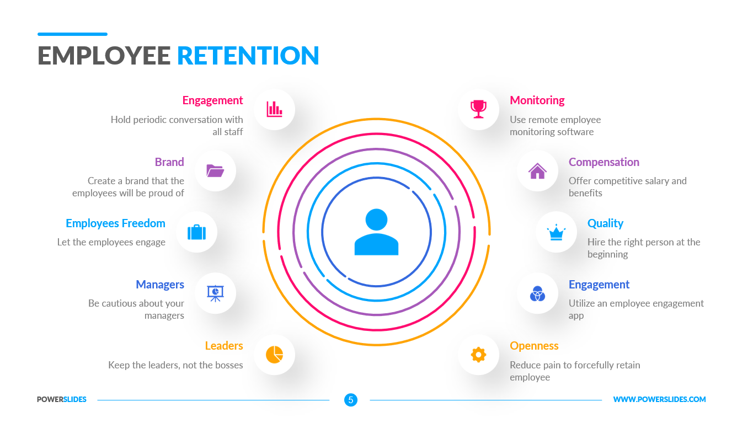
Why is employee retention is so important?
introduction
What is employee retention
Employee Retention is the ability of an organization to retain its employees and ensure sustainability. Employee retention can be represented by a simple statistic. Employee retention is also the strategies employers use to try retain the employees in their workspace.
High retention reduces lost knowledge, hiring expenses and missed revenue opportunities. It amplifies workers contributions, allowing you to make the most of the talent you have and retention drives better performance and improved business outcomes over the long term while delighting your clients and customers.

Slide 5
KPI’S
1.Avereage Attrition rate for all Departments
2.Average Hourly rate of male research scientist
3.Attrition rate vs Monthly income stats
4.Average working years for each departments
5.Job role vs work life balance
6.Attrition rate vs year since last promotion relation

Slide 6
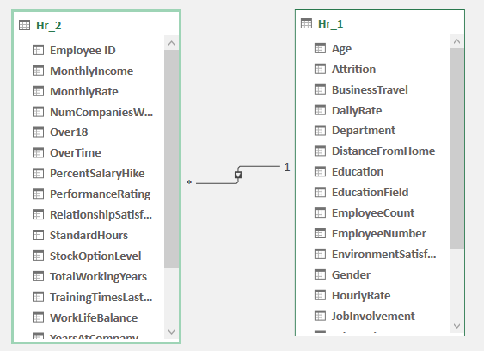
Required connections

Slide 7
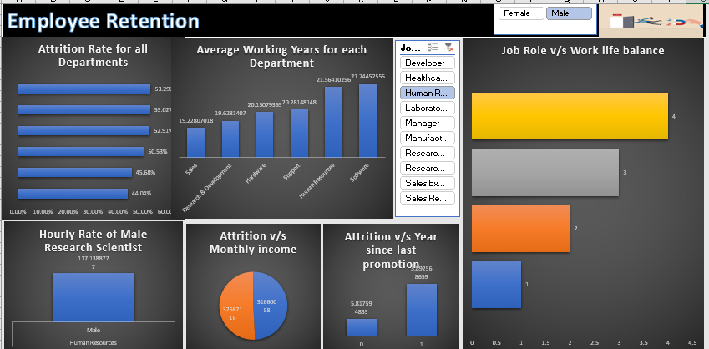
Excel Dashboard

Slide 8
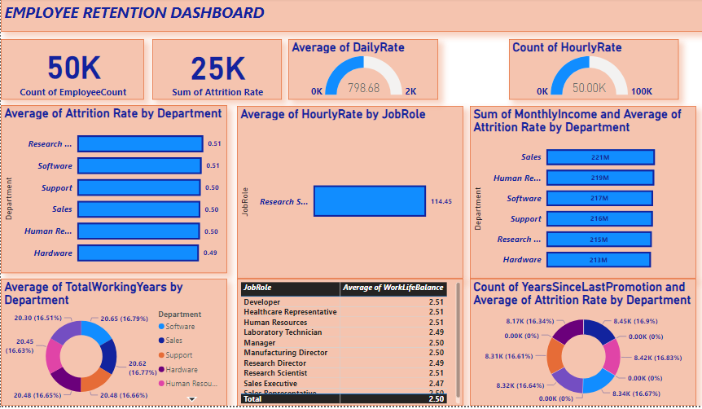
Power bi dashboard

Slide 9
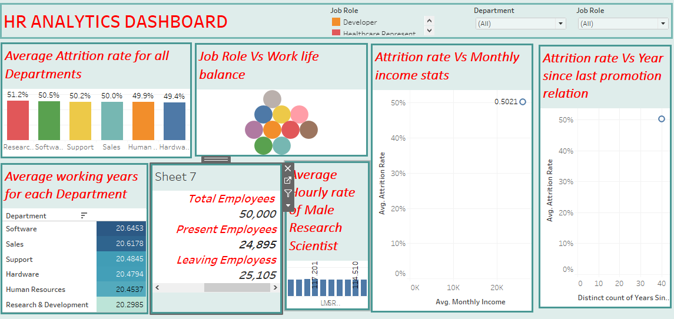
Tableau dashboard

Slide 10
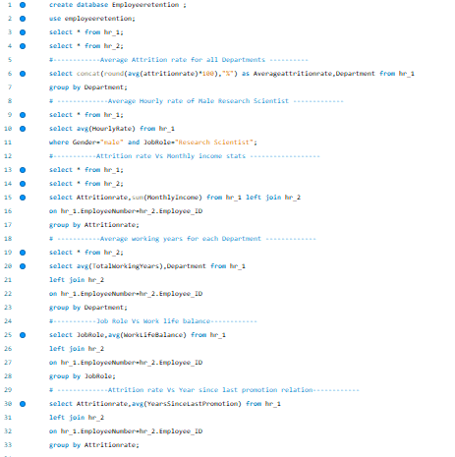
MYSQL Queries

Slide 11
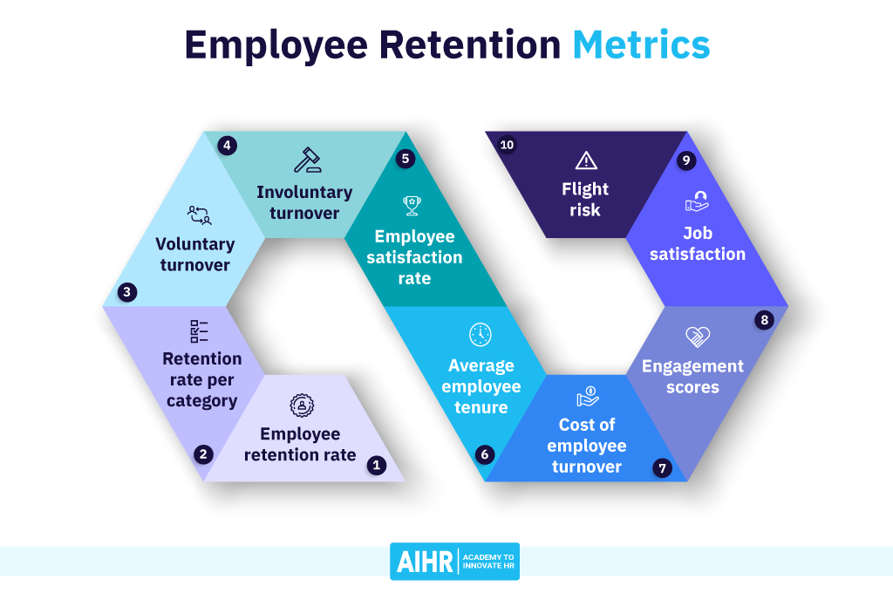
Insights
recommendations
1.Based on the available data total employees are 50k and in that attrition people roughly 25k .
2.Average of daily rate is 798.68
And count of hourly rate is 50k
1.Good Culture
2.Offer Flexibility
3.Create Carrier development plans
4.Employee engagement
5.Communication
6.Training and Development
7.Give Employee opportunities
8.Hire the right people

Slide 12

summary
Employee retention is a phenomenon where employees choose to stay on with their current company and don't actively seek other job prospects. The opposite of retention is turnover, where employees leave the company for a variety of reason

Slide 13
Thank you

